Slide 1
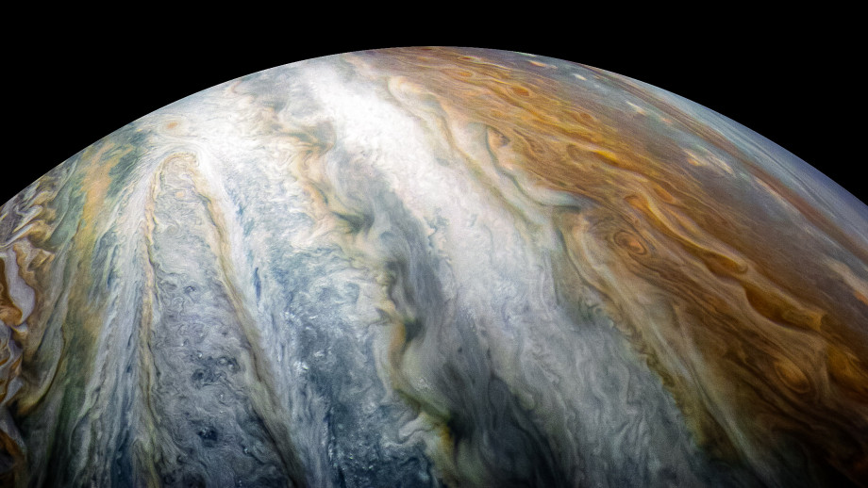
PowerShell in Notebooks

Slide 2

Rob Sewell
Bearded Consultant, Automator,
Trainer
Consultant Sewells Consulting Ltd
dbatoolsMoL dbachecks PowerShell & Data Community
beard.media\book
@sqldbawithbeard
SQLDBAWithABeard.com

Slide 3
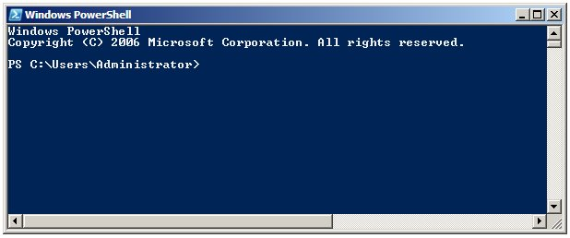
Running PowerShell
2006

Slide 4
Running PowerShell
2006

Slide 5
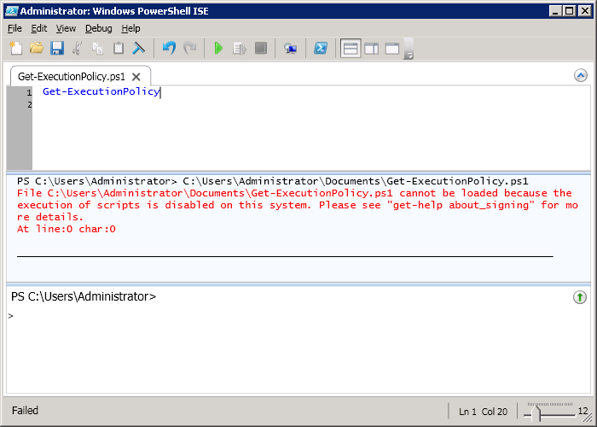
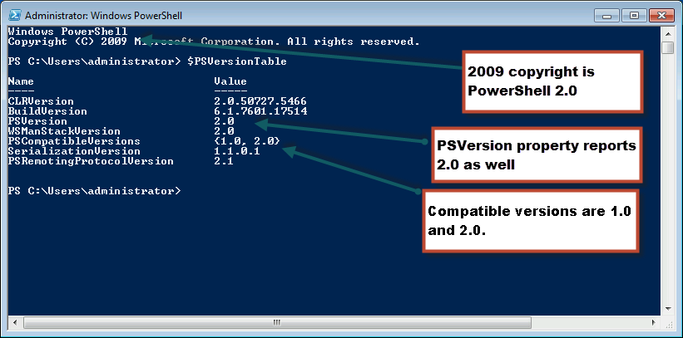
Running PowerShell
2010

Slide 6
Running PowerShell
2010

Slide 7
Running PowerShell
2010

Slide 8
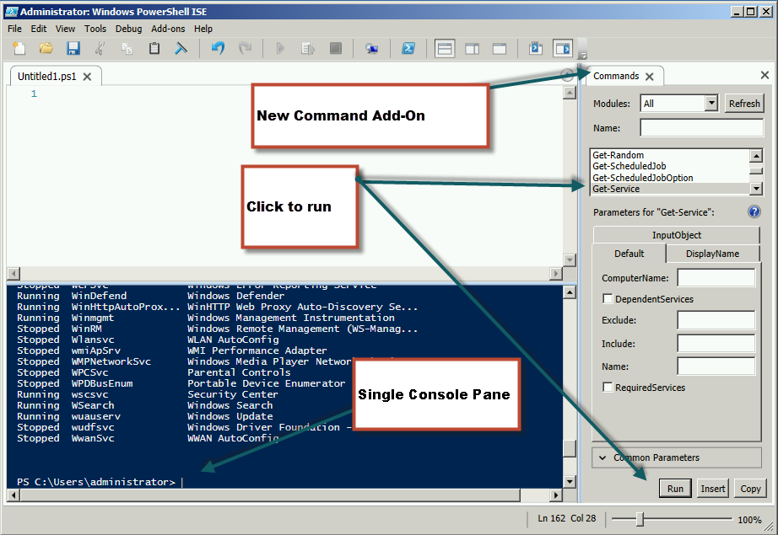
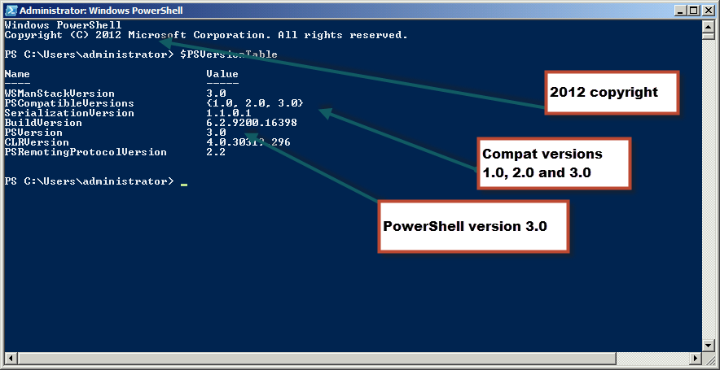
Running PowerShell
2012

Slide 9
Running PowerShell
2012

Slide 10
Running PowerShell
2012

Slide 11
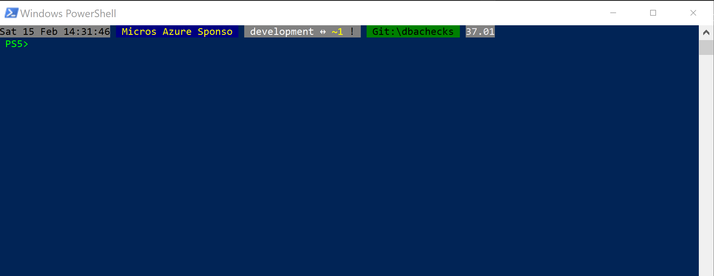
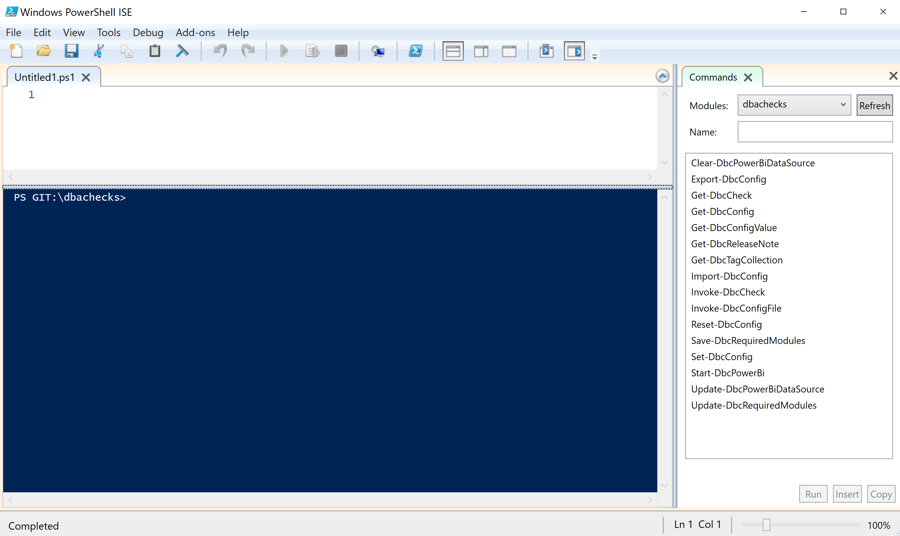
Running PowerShell
2017

Slide 12
Running PowerShell
2017

Slide 13
Running PowerShell
2017

Slide 14
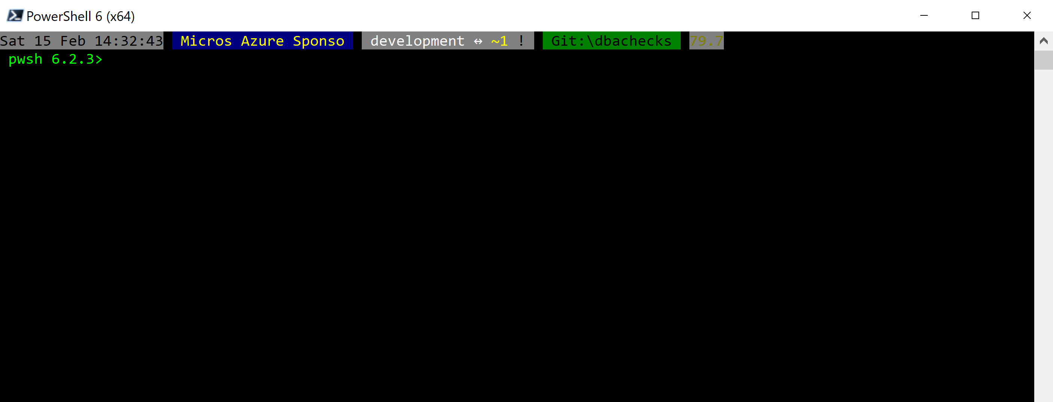
Running PowerShell
2018

Slide 15
Running PowerShell
2018

Slide 16
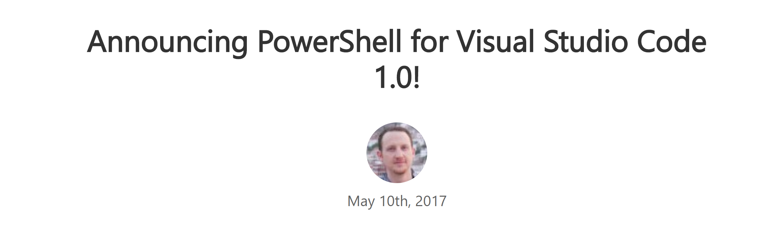
Running PowerShell
2016-17

Slide 17
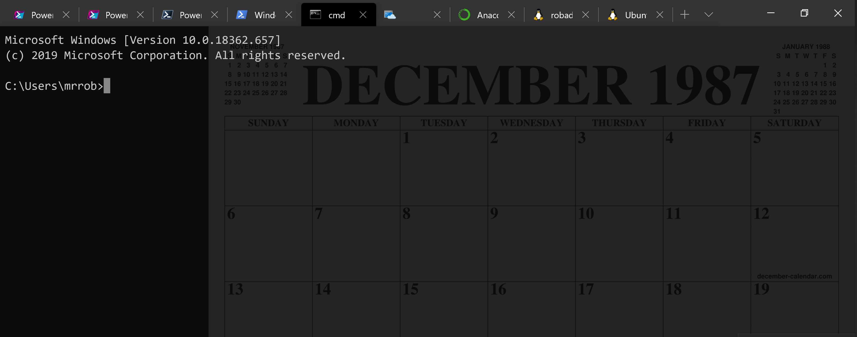
Running PowerShell
2016-17

Slide 18
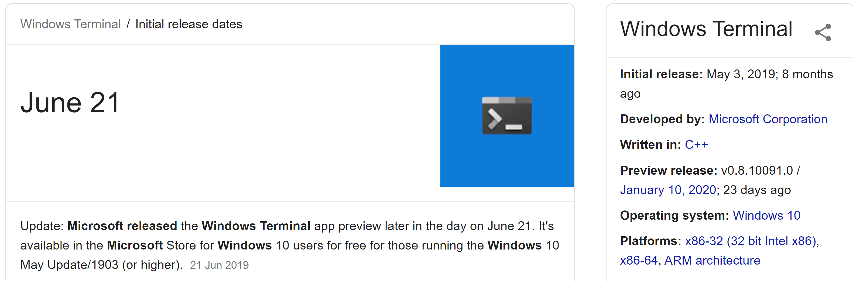
Running PowerShell
2019

Slide 19
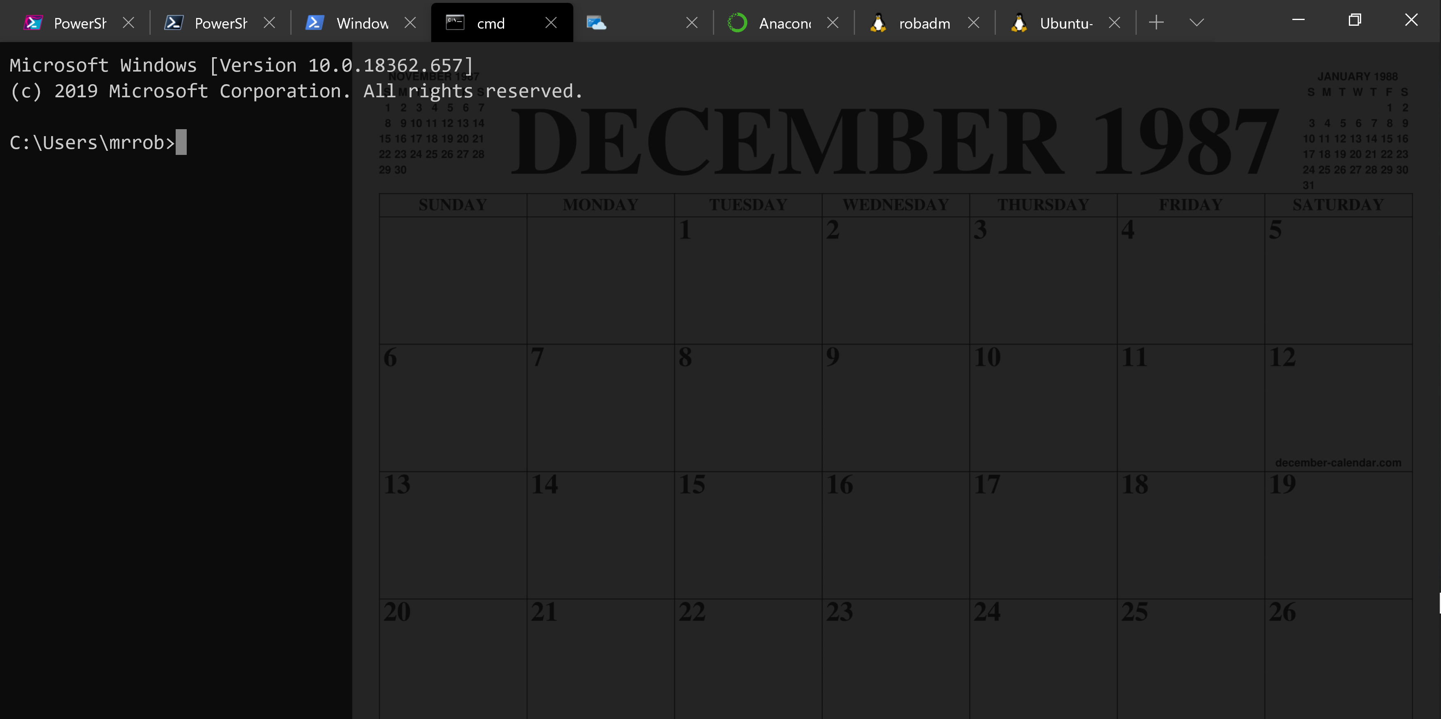
Running PowerShell
2019

Slide 20
Running PowerShell
2019

Slide 21
A Decade and a Half

Slide 22
Uh, Houston, we've had a problem
https://en.wikipedia.org/wiki/Houston,_we_have_a_problem

Slide 23
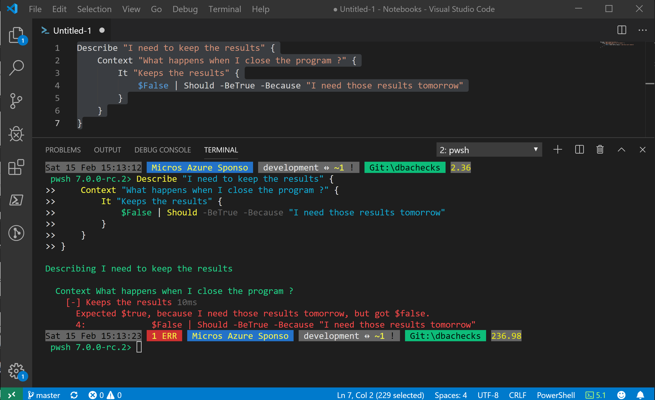
Without some effort………..

Slide 24
Without some effort………..

Slide 25
Without some effort………..

Slide 28


Slide 29


Slide 30
ALL
GONE

Slide 31
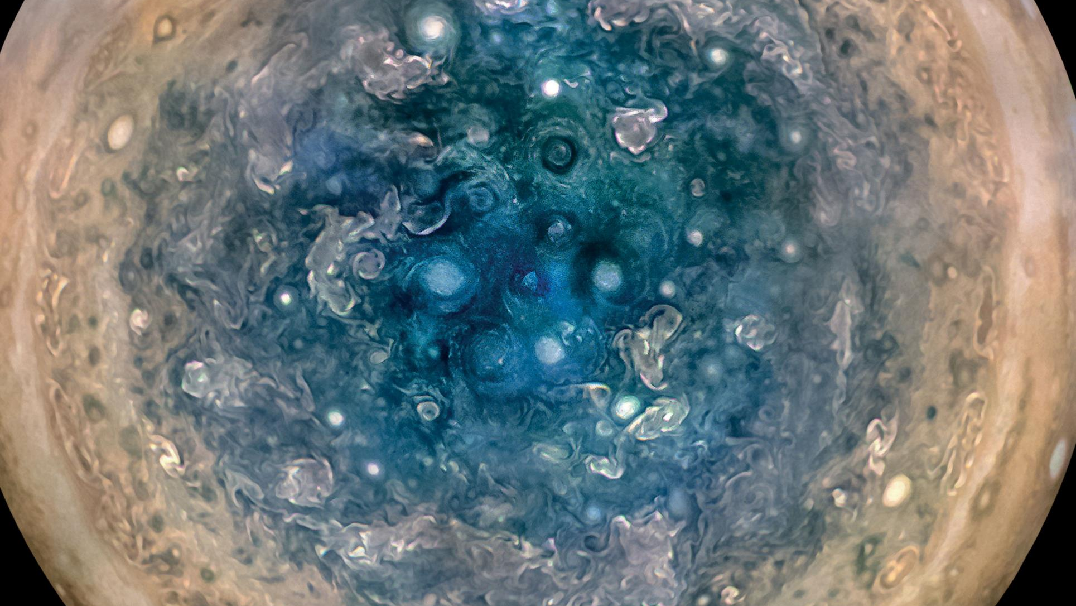

Slide 32
First, the names comes from the planet Jupiter. We wanted to pick a name that evoked the traditions and ideas of science.
Jupyter
@SQLDBAWithBeard SqlDbaWithABeard.com Rob Sewell beard.media/book

Slide 33
Jupyter
First, the names comes from the planet Jupiter. We wanted to pick a name that evoked the traditions and ideas of science.
Second, the core programming languages supported by Jupyter are Julia, Python and R. While the name Jupyter is not a direct acronym for these languages, it nods its head in those directions. In particular, the "y" in the middle of Jupyter was chosen to honor our Python heritage. See the logos of these languages in the languages folder of this repo.
https://github.com/jupyter/design/wiki/Jupyter-Logo
@SQLDBAWithBeard SqlDbaWithABeard.com Rob Sewell beard.media/book

Slide 34
Jupyter
Second, the core programming languages supported by Jupyter are
Julia, Python and R.
While the name Jupyter is not a direct acronym for these languages, it nods its head in those directions.
In particular, the "y" in the middle of Jupyter was chosen to honor our Python heritage.
Third, Galileo was the first person to discover the moons of Jupiter. His publication on the moons of Jupiter is an early example of research that includes the underlying data in the publication. This is one of the core ideas and requirements for scientific reproducibility. Reproducibility is one of the main focuses of our project.
https://github.com/jupyter/design/wiki/Jupyter-Logo
@SQLDBAWithBeard SqlDbaWithABeard.com Rob Sewell beard.media/book

Slide 35
Jupyter
Third, Galileo was the first person to discover the moons of Jupiter. His publication on the moons of Jupiter is an early example of research that includes the underlying data in the publication.
This is one of the core ideas and requirements for scientific reproducibility. Reproducibility is one of the main focuses of our project.
https://github.com/jupyter/design/wiki/Jupyter-Logo
@SQLDBAWithBeard SqlDbaWithABeard.com Rob Sewell beard.media/book

Slide 36

What is a Jupyter Notebook?
Originally for Data Scientists

Slide 37
What is a Jupyter Notebook?
Document that can contain text, code, images and query results
@SQLDBAWithBeard SqlDbaWithABeard.com Rob Sewell beard.media/book

Slide 38
What is a Jupyter Notebook?
Document that can contain text, code, images and query results
@SQLDBAWithBeard SqlDbaWithABeard.com Rob Sewell beard.media/book

Slide 39
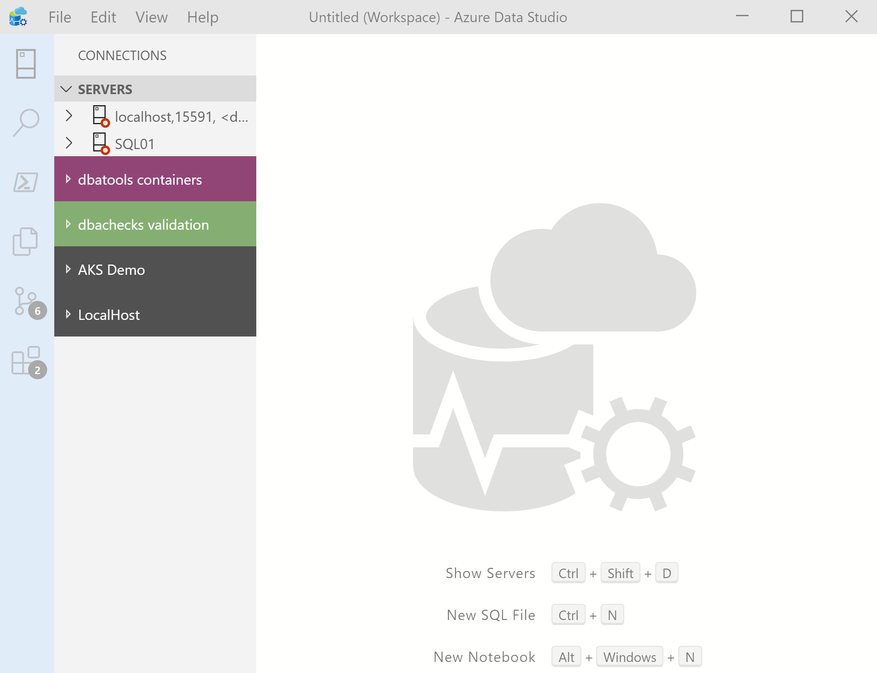

What’s Azure Data Studio ?
Cross Platform desktop environment for Data Professionals
@SQLDBAWithBeard SqlDbaWithABeard.com Rob Sewell beard.media/book

Slide 40
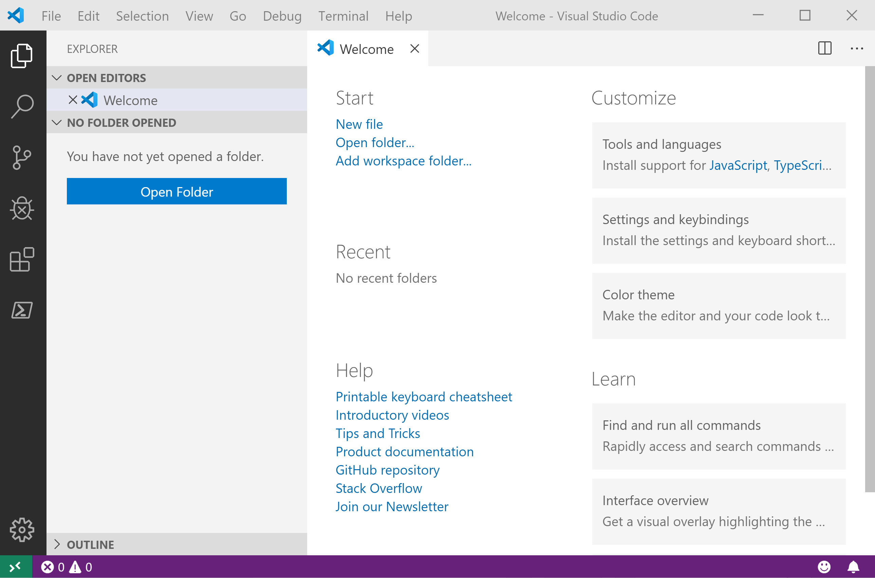
It Looks Like Visual Studio Code ?
@SQLDBAWithBeard SqlDbaWithABeard.com Rob Sewell beard.media/book

Slide 41
It Looks Like Visual Studio Code ?
@SQLDBAWithBeard SqlDbaWithABeard.com Rob Sewell beard.media/book

Slide 42
.NET Interactive Notebooks
Announced at Ignite but preview announced with PowerShell February 6th 2020 https://devblogs.microsoft.com/dotnet/net-interactive-is-here-net-notebooks-preview-2/
@SQLDBAWithBeard SqlDbaWithABeard.com Rob Sewell beard.media/book

Slide 43
.NET Interactive Notebooks
All the goodness of Jupyter Notebooks with added
PowerShell (and C#) (and F#)
@SQLDBAWithBeard SqlDbaWithABeard.com Rob Sewell beard.media/book

Slide 44
Enough talk
Lets see it!
beard.media\book
@sqldbawithbeard
SQLDBAWithABeard.com
@SQLDBAWithBeard SqlDbaWithABeard.com Rob Sewell beard.media/book

